Slide 1
Default probability prediction: Credit data

Slide 2
Overview
[I] Descriptive Data: Missing data, Currency exchange
A
[II] Descriptive Data: Clustering
t-NSE, RSKM
[III] Feature selection
All relevant feature approach:
[IV] Teaching and outreach
Assignment IV
[V] Feedback session

Slide 3
Course information
4 Lectures + 1 feedback session
Attendance required (if unable to attend, send an email before the start of the lecture with reason of absence)
4 seminars
Groups of ± 4 students
Working process determined by students
Report of each group should be uploaded in Portfolio before the next lecture
Writing exercise: each student uploads a written text
Personal Track: logbook of reflections after each lecture (in Portfolio)

Slide 4
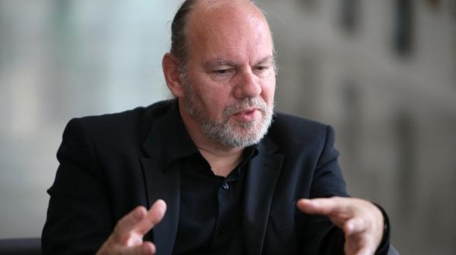
Course information: contact
geert.vanpaemel@kuleuven.be

Slide 5
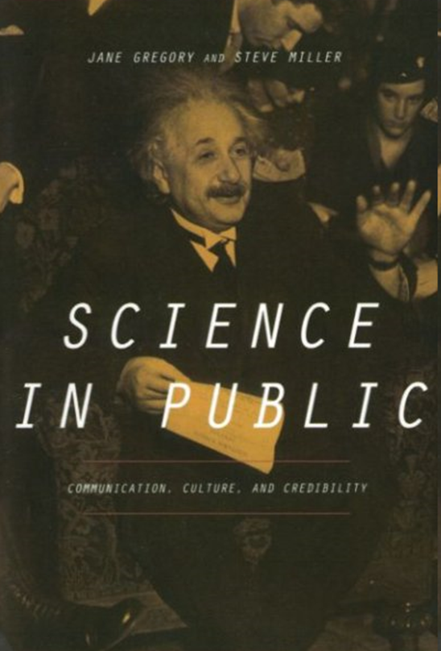

Slide 6
The Public Understanding of Science
Lecture I

Slide 7
Examples
Biophotonics [1’56]
How does meditation change the brain? [2’23]
Nanotechnology [4’39]
Chemicals are awesome [4’38]
The GMO debate [2’39]
Chimpanzee [1’16]

Slide 8
Why science communication?
[FOR SCIENCE] medialization of politics urges science also to be present in the media to legitimize its funding and to make its expertise politically effective
[FOR SOCIETY] to make citizens more critical and sceptical in dealing with knowledge claims and to prepare them for a life in a knowledge economy
[FOR YOURSELF] to express yourself on ‘big issues’ regarding the meaning of science and the fate of society, and on the challenges and rewards of a ‘scientific life’

Slide 9
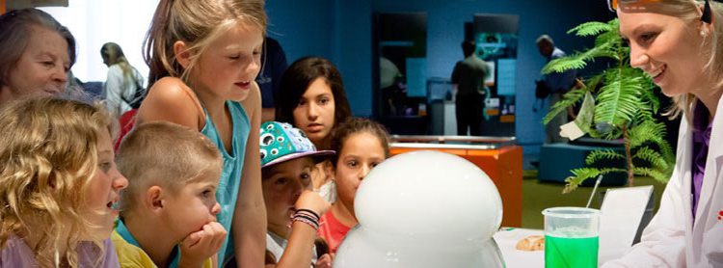
1. A history of challenges and opportunities

Slide 10
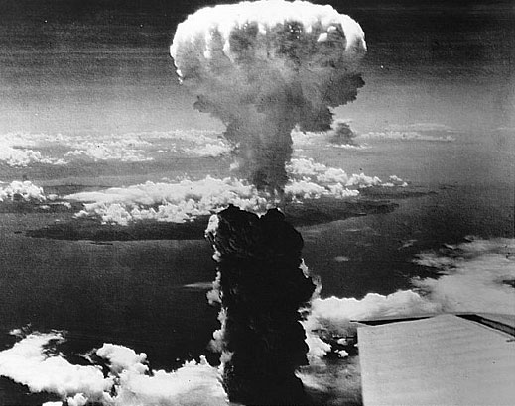
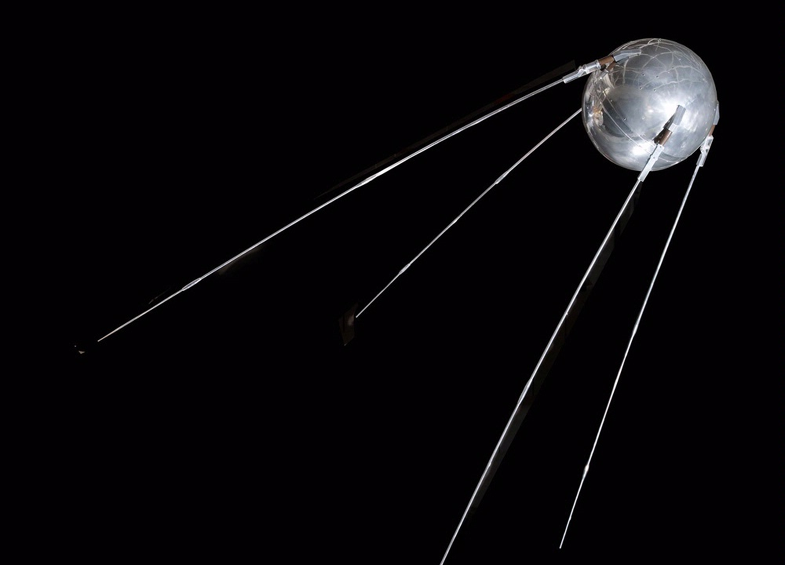
Origins of modern science communication
6 August 1945
4 October 1957

Slide 11
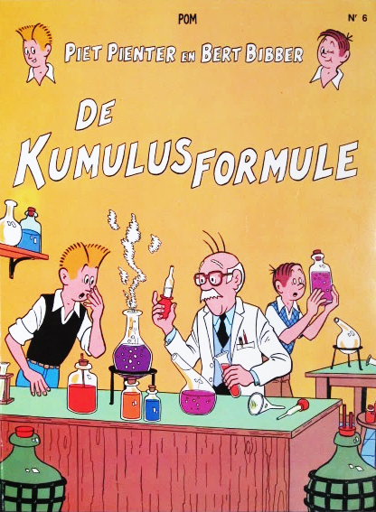
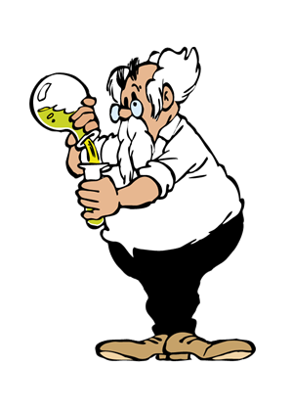
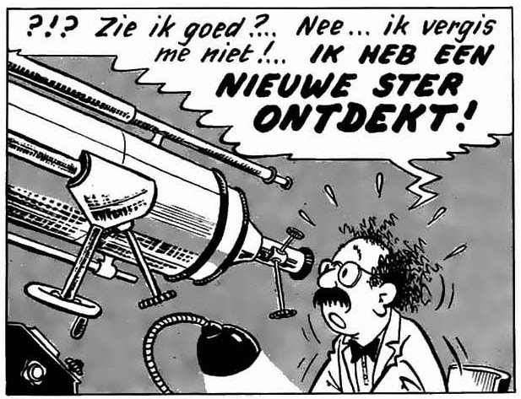
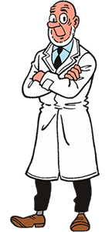
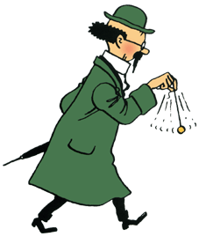
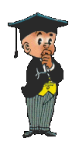
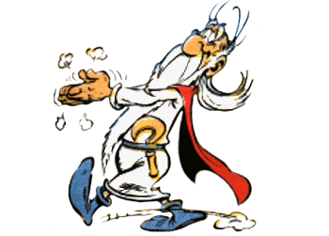
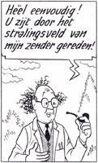

Slide 12
Post-war bonanza
Attitude towards science was generally optimistic, “pro-science euphoria”
The 1950s were “celebratory times for science”
Governments became interested, in particular after Sputnik
Journalists, science writers and commercial publishers took over from scientists

Slide 13
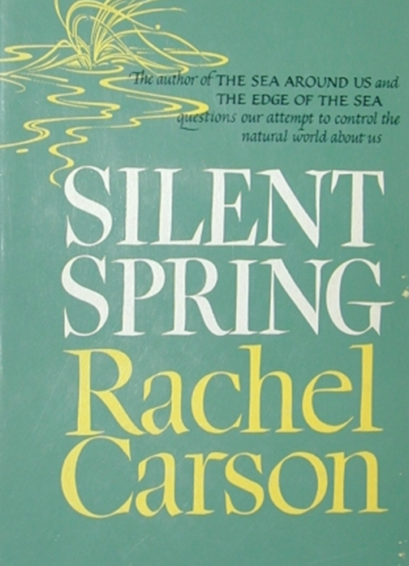
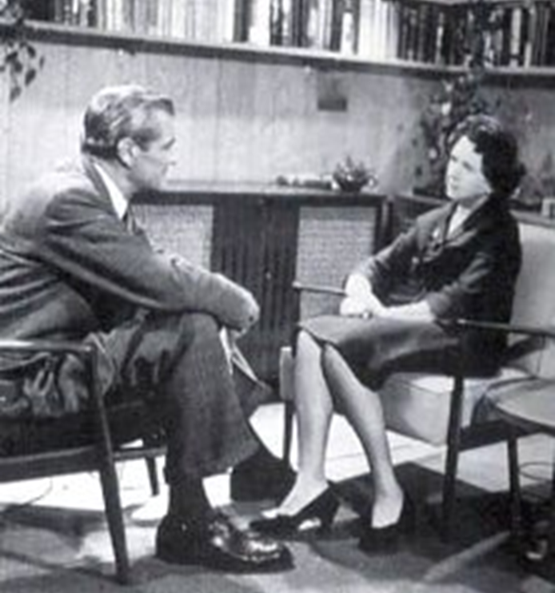
1960s: Waning trust in science
Silent Spring (1962)
Rachel Carson (1907-1964)

Slide 14
Excerpt ‘Silent Spring’
The “control of nature” is a phrase conceived in arrogance, born of the Neanderthal age of biology and philosophy, when it was supposed that nature exists for the convenience of man.
The concepts and practices of applied entomology for the most part date from that Stone Age of science.
It is our alarming misfortune that so primitive a science has armed itself with the most modern and terrible weapons, and that in turning them against the insects it has also turned them agaisnt the earth.

Slide 15
The Bodmer Report (1985)
Report on behalf of the Royal Society ‘to review the nature and extent of public understanding of science [and] to consider the constraints upon the processes of communication”
Signals a re-awakening of the scientific community in the face of the perceived threats of the legitimacy of scientific expertise
The Bodmer Report urged scientists to become engaged in science communication

Slide 16
Should the public trust science?
“Over the past 30 years, the striking trend in the science-society relationship is the increasing private nature of scientific research.
An inevitable consequence of private patronage is the commercialization of science.
In this changing context, a sceptical public is highly desirable. This is, however, contrary to the traditional missions of science communication, which are to promote public scientific literacy and a positive image of science and to generate public acceptance of new technology.
A sceptical public is, after all, the democratized scientific attitude.
(Bauer, M., 2008)

Slide 17
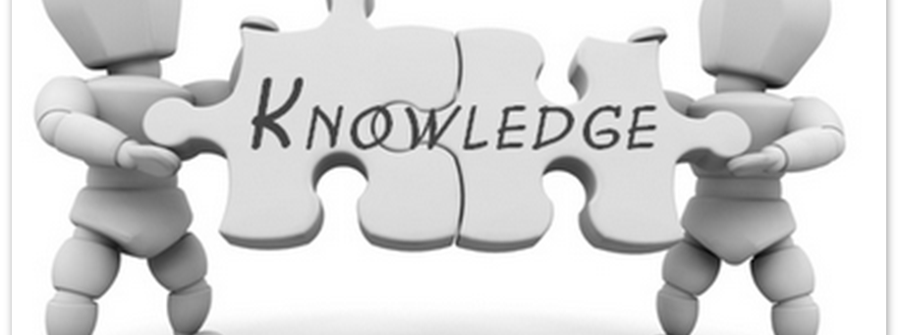
2. How to talk to the public

Slide 18
Three models
The deficit model
The contextual or interactive model
The public science model
[Commercial communication]

Slide 19
The deficit model
The deficit model was ‘invented’ in the late 1980s to explain the failed attempts at science communication in the previous periods
The model starts from the hypothesis that there is a ‘deficit of knowledge’ among members of the public
Science communication should aspire to improve the scientific literacy of the public
Increased levels of scientific knowledge/literacy will lead to a more positive attitude towards science

Slide 20
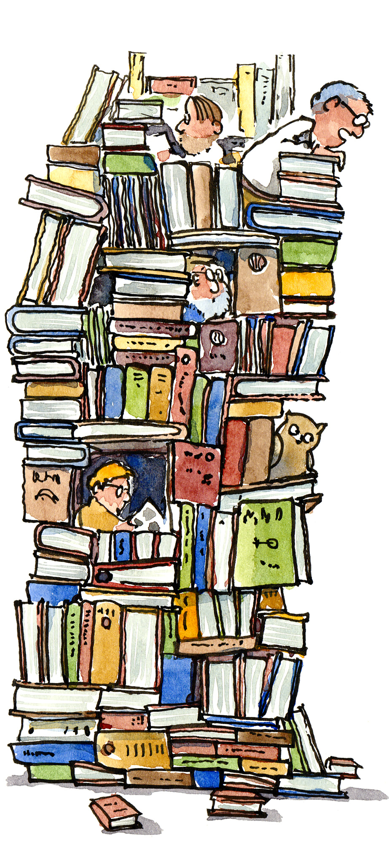
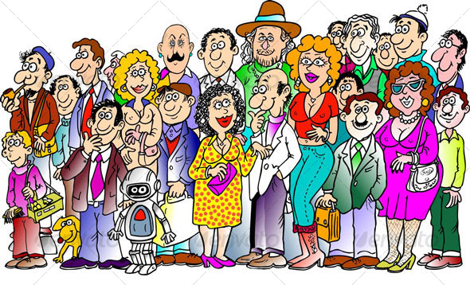
Look up here!
We are scientists!
We are ignorant!
(and a little bit stupid)
We loooove science!
Ssht

Slide 21
Scientific Literacy
“Scientific literacy may be regarded as a basic survival skill in a scientifically and technologically sophisticated society.
To be scientifically literate is not to be expert in anything in particular, but rather to be able to deal effectively with matters scientific as they arise in the course of life; it is to be able to cope with science in a way that is both respectful of scientists' legitimate expertise and wary of their many fallibilities and weaknesses; it is to be able to recognize science for what it is, and thus to make discerning judgments about its personal and social relevance.”
(Thomas, G. & Durant, J., 1987)

Slide 22
‘Civic scientific literacy’
The scientifically literate citizen needs to possess facts and vocabulary sufficient to comprehend the context of daily news
“a vocabulary of basic scientific constructs sufficient to read competing views in a newspaper or magazine . . . an understanding of the process or nature of scientific inquiry . . . some level of understanding of the impact of science and technology on individuals and on society.” (Miller, 1998)
By this definition not more than one-quarter of the European and US publics qualify as scientifically literate. Moreover, this situation has hardly changed since systematic measurements first began in the late 1950s, despite the best efforts of governments and educators alike to popularize science.

Slide 23
Miller, J. (2006)

Slide 24
“My analysis shows that literacy and scientific ideology are negatively correlated in most countries, and the higher scientific literacy and scientific productivity the more likely knowledgeable citizens will reject a scientific ideology.
The ‘deficit concept’ of public understanding of science is falsified: the more we know the science, the less we love it.”
Bauer, M. (2008)

Slide 25
The contextual model
The declining public trust in science was considered to be a consequence of a general mistrust of institutions and authorities, in particular the role of industry and politics.
The public doubted the objectivity and neutrality of science and scientists.
Emphasis was placed on the context through which scientific information was conveyed to the public.
Not the amount of scientific information, nor the capacity of the public to ‘learn’ was considered of prime importance, but the amount of trust that could be generated.

Slide 26
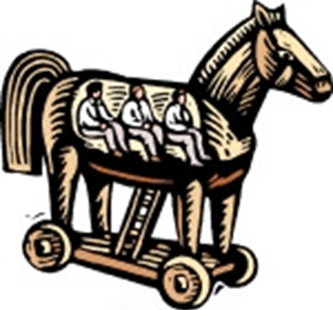
We are scientists inside a Trojan horse! You can’t see us!
Pretty awesome special effects…
Keep quiet boys!
A talking horse!

Slide 27
Nothing new?
In many ways the contextual model remains within the older ‘deficit’ view of science communication. The public is deemed to need guidance. Scientists (or better: professional communicators) ought to lead the public towards a better understanding of their own life.
Even more than in the deficit model, science is in need of simplification and adaptation to the needs of commmunication.
Science communication shifts from emphasis on content towards form, similar to a marketing campaign
‘Real’ science remains inaccessible and unaccountable.

Slide 28
The public science model
Knowledge is generated by members of the public, based on common sense, shared expectations, and accessible information. It is the aim of science communication to help the public to take account of scientific arguments in forming an opinion.
This approach emphasizes cultural representations and public definitions of “science”, and how these various public meanings relate to acceptance or reservations about science.

Slide 29
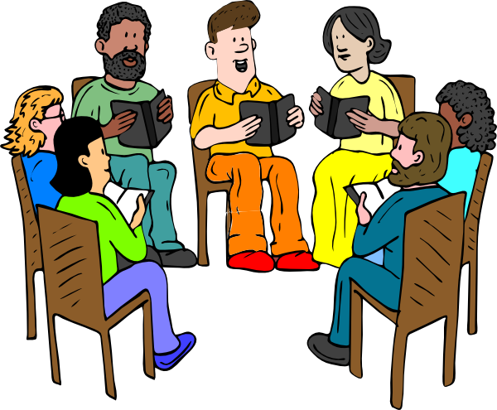

We’re the public talking about science.
You want to join?
We’re scientists talking about science.
…not to loud…

Slide 30
Public science as another kind of science
Knowledge oriented towards confirmation of values (health, safety, faith, happiness, future etc.) with direct impact on philosophy, ethics, etc.
Arguments are based on personal experience, anecdotes, short reasoning cycles, etc. as they are effective in face to face conversation.
Knowledge is more valuable when the source of knowledge is more personalized and/or exclusive (famous scientists, spectacular events, exclusive environments,…)
Knowledge is connected to social differentiation (status). It confers social distinction on the knower.

Slide 31
Complementarity principle
All three models can be used simultaneously, depending on audience, topic and aims.
Deficit model: for uncontroversial, necessary information based on scientific consensus. Information coincides with accepted rational behaviour of the public
Aim: Information dissemination
Formats: (semi-)formal lecture, brochure, scientific environment (laboratory, field work),…
Channel: organized by scientists, organizations,…
Contextual model: when science is controversial or uncertain, tied up to institutional agents, and/or when some resistance can be expected
Aim: Influencing attitude, persuasive communication
Formats: entertainment, visuals, story telling, emotions (wonder, fear, excitement),…
Channel: mass media, science journalism
Public science model: when science alone cannot provide a solution, when normative, ethical choices have to be made
Aim: empowering people, raising awareness, making sure science is part of discourse
Formats: interview, problem oriented topics,…
Channel: communities (from local to virtual)

Slide 32

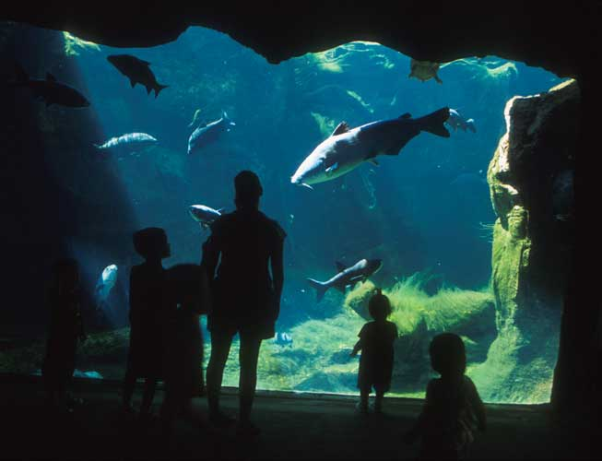
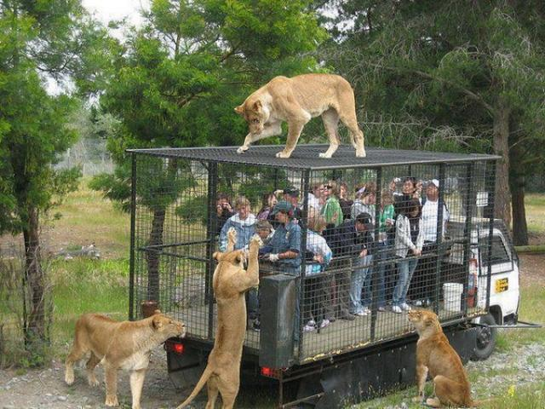

Slide 33


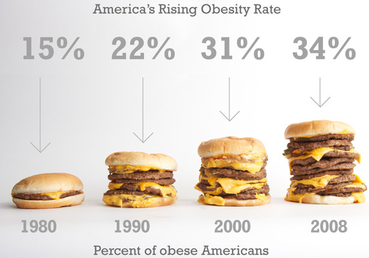

Slide 34
Seminar #1
Compare four different examples of science communication (article, website, blog, youtube clip, tv documentary, lecture, book,…)
Discuss the characteristics of each of them
Aim of communication?
Contribution to scientific literacy? How?
Features of which model?
Effectiveness of communication? Explain

